Slide 1




28/10/25 16:44:54
THREE LAYER BLOWN FILM LINE
ID
PASSWORD
Log In
MODEL : -RECF-2550-40-1800

Slide 2


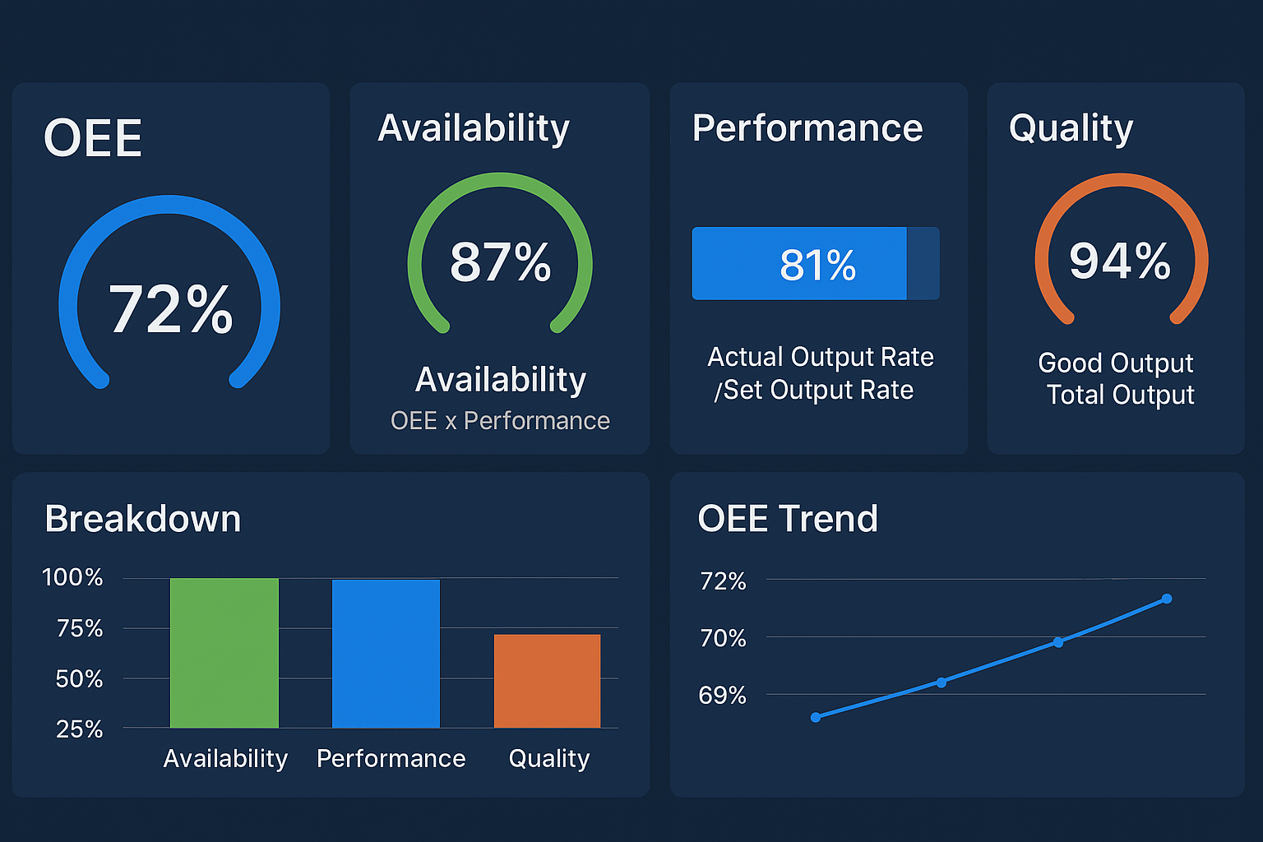
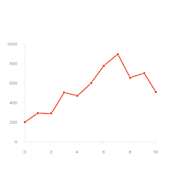
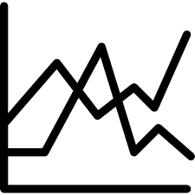
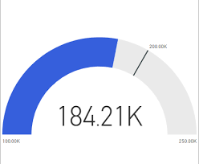
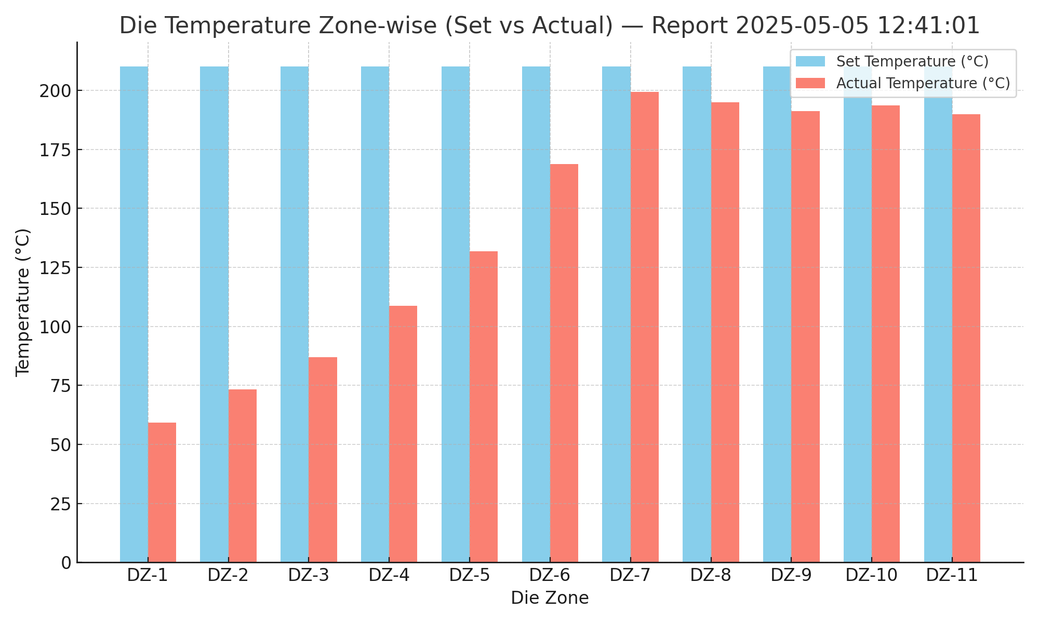
Running
THREE LAYER BLOWN FILM LINE
Plant Communication
28/10/25 16:44:54
MACHINE OVERVIEW PANEL
OVERALL EQUIPMENT EFFICIENCY
LAYERS
Total Set Output
Total Act Output
Density
GSM
Lay Flat
LAYER 1
210.00
210.70
0.92
92.86
92.86
LAYER 2
LAYER 3
LIP PROFILE
IBC TEMPERATURE IN V/S OUT
SET V/S ACT LINE SPEED
EXTRUDER
EXTRUDER 1
EXTRUDER 2
DIE TEMPERATURE ZONE WISE
MAP PROFILE
EXTRUDER 3
WINDER
WINDER 1
WINDER 2
THICKNESS
SET THICKNESS : 0000
AVERAGE THICKNESS : 0000
NOMINAL THICKNESS : 0000
MAXIMUM THICKNESS : 0000
MINIMUM THICKNESS : 0000
GBR POSITION : 0000
UTILITIES
REPORTS
MATERIAL UTILIZATION
MODEL : -RECF-2550-40-1800

Slide 3

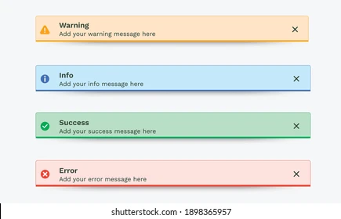
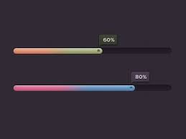
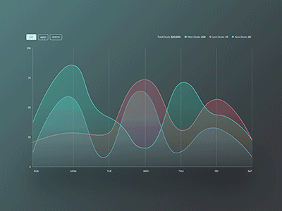
WINDER 1/2
28/10/25 16:44:54
TOTALIZER
210.00
WINDER
WINDER 1
WINDER 2
ROLL LENGTH
ROLL DIA
MODEL : -RECF-2550-40-1800

Slide 4
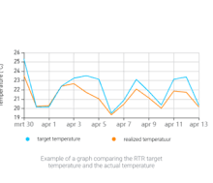
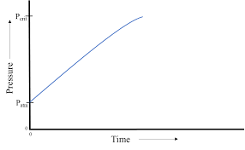
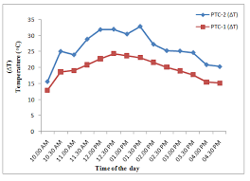
LAYER 1/2/3
28/10/25 16:44:54
SPEED
YIELD
AMPERE
210.00
210.00
210.00
MELT PRESSURE
Set v/s Act Thickness
MELT TEMPERATURE
LAYERS
LAYER 1
0.06
30.90
LAYER 2
LAYER 3
MODEL : -RECF-2550-40-1800

Slide 5
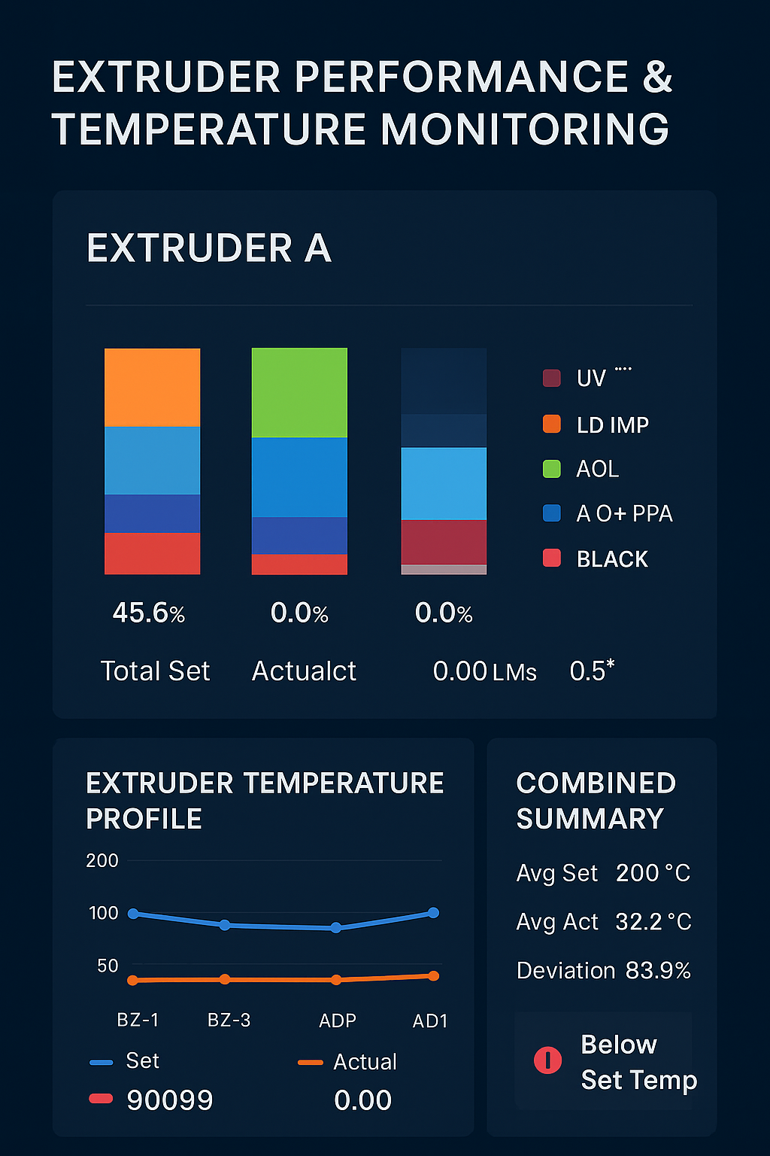
EXAUSTER A/B/C
28/10/25 16:44:54
EXTRUDER
EXTRUDER A
EXTRUDER B
EXTRUDER C
MODEL : -RECF-2550-40-1800

